Slide 1

Chapter 1 Introduction to Group Communication

Slide 2
This is to find solution IF you have an unwanted member
A: prepare ppt
B: prepare music
C: prepare games
D: present
D absent on presentation date, what will you do?

Slide 3
Group report
(100 words) Group introduction:
(150words) Group goal: make money / travel/ discover HCMC/ gym/ lose weight/ make up / small marketing project…...
Deadline: 5 weeks
Final products: a video clip to show in class
Possible / clear / enough motivation
Action plan

Slide 4
Set a goal for your group
Long – self - good program
Read book -> support study -> personal development
Play game -> fun -> personal relax
Study what I like personal development
Thục – family+ fish+cat
Read book => work => salary
Play game => JOB => salary
Study => job => salary
Money=> bills => family

Slide 5
Set a common goal for your group 15’
A: collect ideas + take note
B: make sure everyone speak English
C: report back
D: ask questions

Slide 6
How to Succeed in Groups
Listen effectively
Understand your role
Actively contribute
Ask clear questions
Establish a professional rapport

Slide 7
How to Succeed in Groups p.3
Communicate effectively with culturally-diverse members (observe, open, respect, respected)
Use language effectively
Convey a professional image
Resolve group conflict
Demonstrate leadership
Notes:
Your professional image is the set of qualities and characteristics that represent perceptions of your competence and character as judged by your key constituents (i.e., clients, superiors, subordinates, colleagues).
Q: What is the difference between "desired professional image" and "perceived professional image?"
A: It is important to distinguish between the image you want others to have of you and the image that you think people currently have of you.
Most people want to be described as technically competent, socially skilled, of strong character and integrity, and committed to your work, your team, and your company. Research shows that the most favorably regarded traits are trustworthiness, caring, humility, and capability.

Slide 8
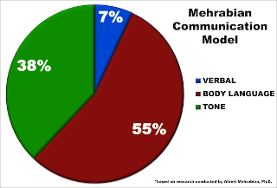

Slide 9
Do you have any shared goal?
How to find people share your goal?

Slide 10

Desired/wish PROFESSIONAL Image Perceived Image

Slide 11
Leadership
https://www.youtube.com/watch?v=3zU2ACDASx8

Slide 12
QUIZ
WHAT DO YOU CALL A TEACHER WHO TREATS SE STUDENTS BETTER THAN SB STUDENTS? discrimination
List down 3 components of group communication process-
What is NOISE in group communication- 5 sense, sound, sight, taste, touch, smell
The perfect number of group member is_7____
DIALECTIC: individual-group_______

Slide 13
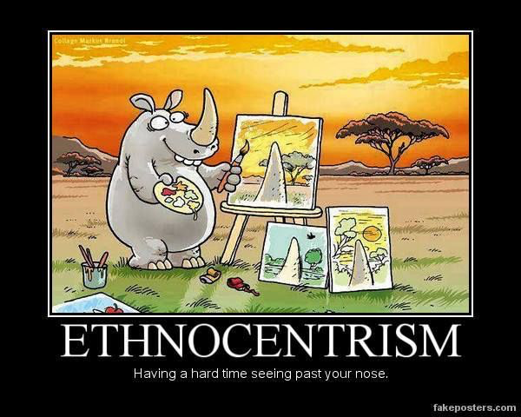
IF U HAVE A RHINO IN YOUR GROUP, WHAT WILL HAPPEN?

Slide 14

Stereotype frame of thinking

Slide 15
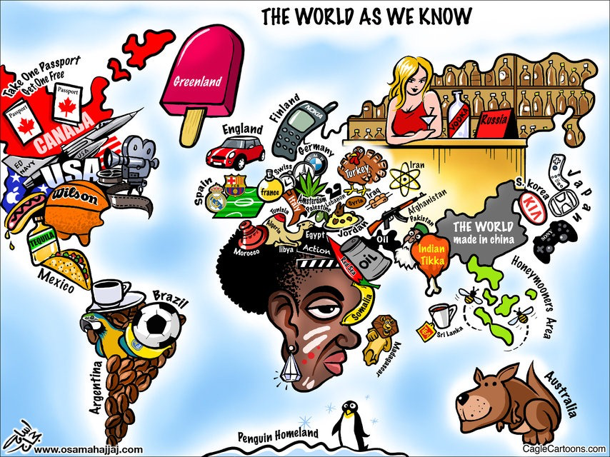

Slide 16
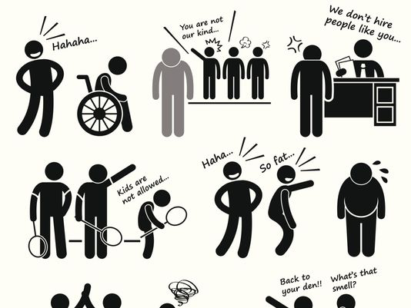
Discrimination

Slide 17
Can we discriminate someone without knowing it?
Dear Mr/ Mrs

Slide 18
Defining Group Communication
The interaction of >= 3 interdependent members working to achieve a common goal clear for everyone
Notes:
Example

Slide 19
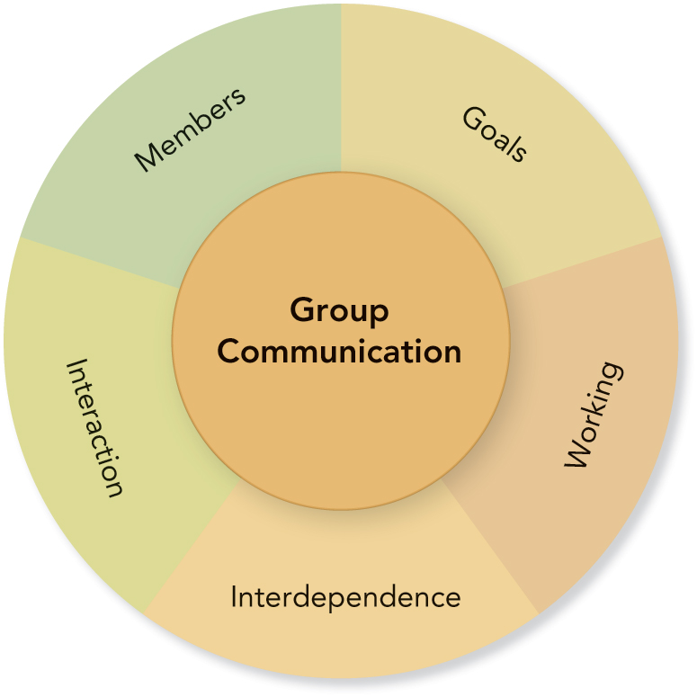
Components of Group Communication

Slide 20
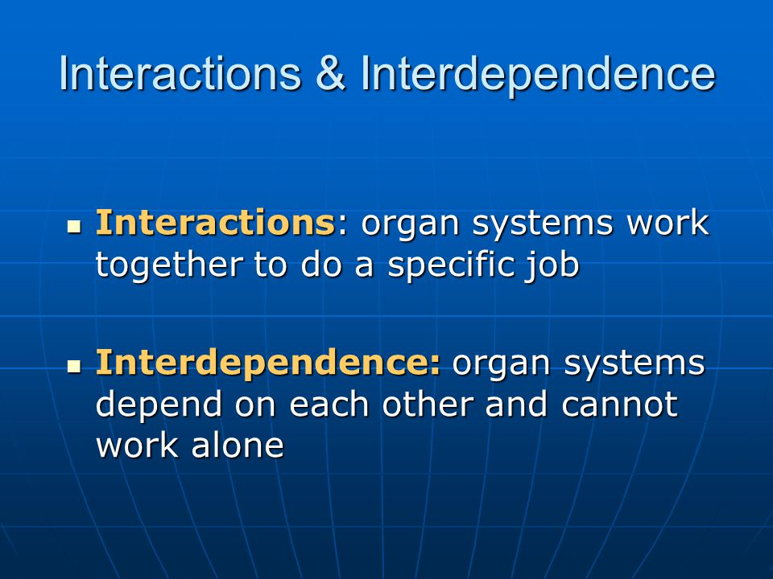

Slide 21
Defining Group Communication p.4-
Three or more members
How are groups limited when there are less than 5 members?
How are groups limited when there are more than 12 members?
What is the ideal size for a problem-solving group?

Slide 22
Defining Group Communication
Interaction
Group members use verbal and nonverbal messages to generate meanings and establish relationships.
Group communication requires interaction.

Slide 23
Defining Group Communication
Common Goal
Defines and unifies a group
A clear, elevated goal:
separates successful from unsuccessful groups
guides action
Helps set standards – microsoft, fsoft
helps resolve conflict
motivates members
Notes:
vip

Slide 24
Defining Group Communication
Interdependence
Each group member is affected and influenced by the actions of other members.
Working
Group members work together to achieve a common goal.
Notes:
Example: 1 girl in a boy group, 1 mem sleep while group is working, 1 mem goes to toilet/ late

Slide 25
PowerPoint Quiz
Which of the following situations best represents group communication?
People talking about politics in an elevator
People discussing the weather in an airport
Parents cheering at a school soccer match
Jury members deliberating a court case
An audience listening to a concert

Slide 26
Communication Process: Basic Elements
Members
Messages
Channels
Feedback
Context
Noise

Slide 27
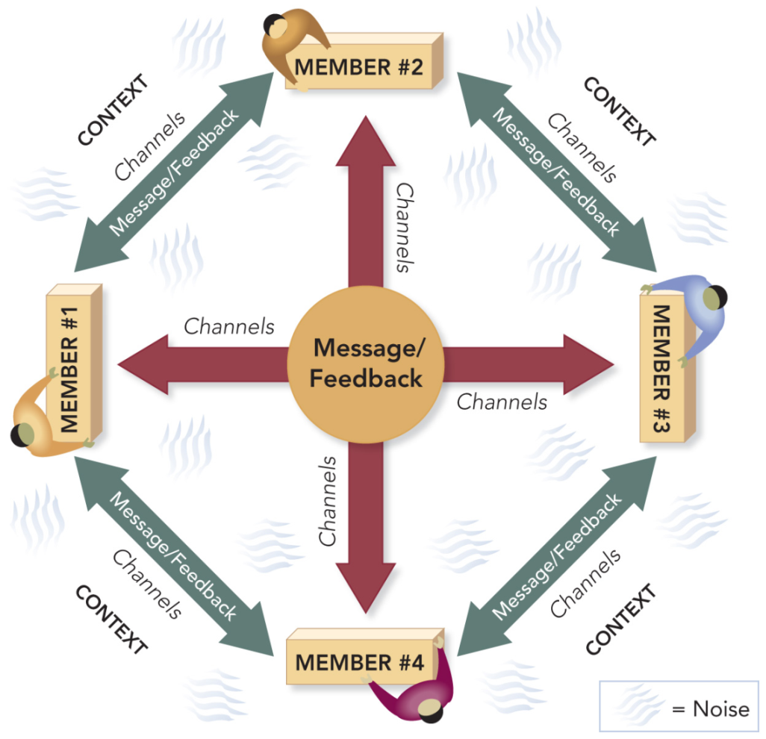
Group Communication Process

Slide 28
Group Communication Process: Match the Concepts
A. Members
B. Messages
C. Channels
D. Feedback
E. Context
F. Noise
_F_ Anything that interferes with or inhibits communication
_B_ Ideas, information, opinions, feelings
_C_ Media used to share messages
_A_ Recognized and accepted as belonging to a group
_D Response or reaction to a message
_E_ The physical and psychological environment

Slide 29
Your group will answer 1 question in a piece of paper 100 words
HOW Groups receive input and produce output? Hùng
WHY SHOULD Members are interdependent? What will happen IF members do not interdependent? Duy
What is a good group goal? Khánh
Why are Groups unpredictable? Ân
How can Groups balance contradictory tensions between members? Bách

Slide 30
Basic Types of Groups p.7
Primary Groups
Social Groups
Self-Help Groups
Learning Groups
Service Groups
Civic Groups
Work Groups
Public Groups

Slide 31
Match the Types of Groups P. 7
_C_ Alcoholics Anonymous
_A_ Bowling Team
_G_ Boy or Girl Scout Troop
_BGAE_ Church Choir
_F D_ SE teaching team
_EG_ Group Counseling
_FDA_ PROFESSIONAL
_AF_ PDP DEPARTMENT
A. Primary Group
Social Group
Self-help Group
D. Learning Group
Service Group
Work Group
Public Group
(In some cases, more than one type may apply)

Slide 32
Match the Types of Groups P. 12
A. Primary Group (GANG, BAND)
B. Social Group (VOLUNTEER, +)
C. Self-help Group
D. Learning Group
Service Group
(In some cases, more than
one type may apply)
_C_ Alcoholics Anonymous
_D_B_A_ Bowling Team
_B_C_ Boy or Girl Scout Troop
_E_ Church Choir
_A_ “Tribe” on Survivor
_B-E- Group Counseling
_A_ PROFESSIONAL KILLERS

Slide 33
Additional Types of Groups
Work Groups:
Committees
ad hoc
standing
task force
Work Teams
Public Groups:
Panel Discussion
Symposium
Forum
Governance Group

Slide 34
Advantages of Working in Groups: Provide Examples (P.13-14)
Group Performance
Member Satisfaction
Learning
Cultural Understanding
Creativity
Civic Engagement / COMMUNITY CONNECTION

Slide 35
Disadvantages of Working in Groups (P.9)
Time, Energy, and Resources
PP Conflict
People Problems ________

Slide 36
Balance and Group Dialectics
Group Dialectics
The competing and contradictory components of group work
Balancing Group Dialectics
The challenge of taking a both/and rather than an either/or approach to resolving dialectic tensions in groups

Slide 37
The Opposite Proverb Is . . .
_____________________
_____________________
_____________________
_____________________
Birds of a feather flock together
He who hesitates is lost.

Slide 38
Balancing Group Dialectics
Individual Goals ↔ Group Goals
Personal goals are compatible with group goals.
Conflict ↔ Cohesion
Cohesive groups are committed, unified, and willing to engage in conflict.
Conforming ↔ Nonconforming
Members value group norms, but are willing to change.

Slide 39
Balancing Group Dialectics
Task Dimensions ↔ Social Dimensions
Members want to get the job done and also value their social relationships.
Homogenous ↔ Heterogeneous
Members value member similarities and differences.
Leadership ↔ Followership
Effective leadership requires loyal and competent followers.

Slide 40
Balancing Group Dialectics
Structure ↔ Spontaneity
Members recognize the need for structured procedures and the value of creative thinking.
Engaged ↔ Disengaged
Members expend energy and work hard, but also need rest and renewal.
Open System ↔ Closed System
Members welcome input and interchange, but also protect the group and its work.

Slide 41
Ask me 3 academic questions
What to do when leader-chap 4 lazy-chapter 3? => check what your leader needs.
What about 1 lazy-leader people-5 + 2 hard working-10-chapter 7-conflict in 1 group? => check group goal? Check role – chapter 3
Who should be leader-chapter 4? Goal .

Slide 42
Match and Define the Dialectics
___ Closed
___ Disengaged
___ Spontaneity
___ Followership
___ Heterogeneous
___ Social
___ Nonconforming
___ Cohesive
___ Group
A. Individual
B. Conflict
C. Open
D. Structure
E. Conformity
F. Leadership
G. Engaged
H. Homogeneous
I. Task

Slide 43
Ethics and Balance
Do group members agree upon and apply standards of right and wrong to group situations and member interaction?
Do group members follow the National Communication Association Credo for Ethical Communication? (attached file in LMS – chapter 1)

Slide 44
Apply the NCA Ethics Credo
In requesting funds for a school club, the officers exaggerate their needs and suggest that other clubs waste money.
Which ethics credo principle(s) have the officers violated?
A. We advocate truthfulness, accuracy, honesty, and reason.
We condemn communication that degrades individuals . . .
C. We accept responsibility for the short- and long-term consequences of our own communication.
D. We strive to understand and respect other communicators before evaluating and responding to their messages.

Slide 45
PowerPoint Quiz
Aristotle offered the “doctrine of the mean” as a balanced approach to ethical behavior. He advised that when you face an ethical decision, you should . . .
a. select an appropriate response somewhere between two extremes.
b. select a response that benefits the most people.
c. select a response that benefits you the most.
d. select a response that is at the midpoint between two extremes.

Slide 46
Criteria of top uni
The performance indicators are grouped into five areas:
Teaching (the learning environment)
Research (volume, income and reputation)
Citations (research influence)
International outlook (staff, students and research)

Slide 47
What advantage does the below bring in WIG? Page 9
Uni do survey on company recruitment requirement to edit their study programs that match the company’ requirement => civic engagement
Video testers test the video before launching => learning/ creativity
Invites an IT teacher to be guest speakers to deliver a short talk in BUSINESS class => cultural understanding / superior resource
Criteria of an international university: 20-30% of international staff and students => civic engagement/ member satisfaction/cultural understanding

Slide 48
What disadvantages of WIG reflect in the below statements?
My dog is sick today.- heart/ sleep/ health/ family/ character/ shy/ active/ smell/ => people problem /personal problem
Hiếu said: “I want to focus on vovinam only.” => personal pp
I already said it 3 times as you come 1 by 1. => time
I will follow my own method. => conflict

